Slide 1
Power CAT AI WEBINARS
Building an AI-ready organization

Slide 2


Meet your hosts
Ashleigh Nyazema
Robert Standefer
Program Manager​
Power CAT​
Principal Program Manager
Power CAT​

Slide 3
What we will talk about today
Why we’re talking about extending agents
What Azure AI offers for extending agents
How you can use AI Foundry to extend agents
Key scenarios for extending agents with AI Foundry

Slide 4



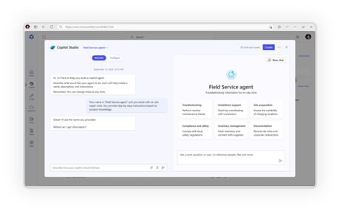
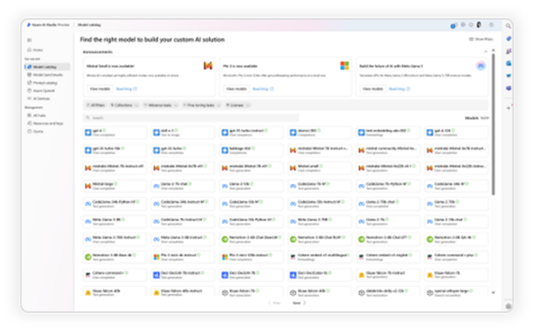
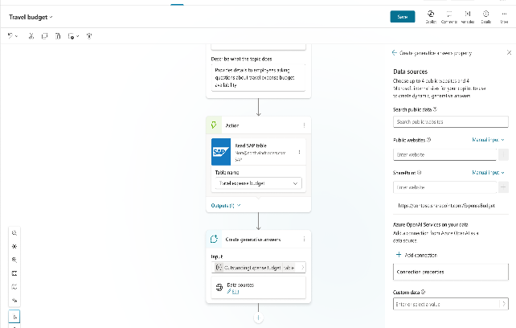
Choice of tools to create agents
No code
Pro code
Agent builder
Copilot Studio
Copilot Studio, Azure AI Foundry & Visual Studio

Slide 5
Start with Copilot Studio and extend with Azure AI

Slide 6
Why this matters now
Your Copilot Studio agents are delivering value
You need enhanced capabilities without rebuilding
You want the same agents, with smarter outcomes

Slide 7
Signs your Copilot Studio agent is ready for more
Users asking complex questions your agent can’t answer well
Document-heavy scenarios requiring deeper analysis
Industry-specific needs beyond general knowledge
Integration demands with specialized data sources
1
2
3
4

Slide 8





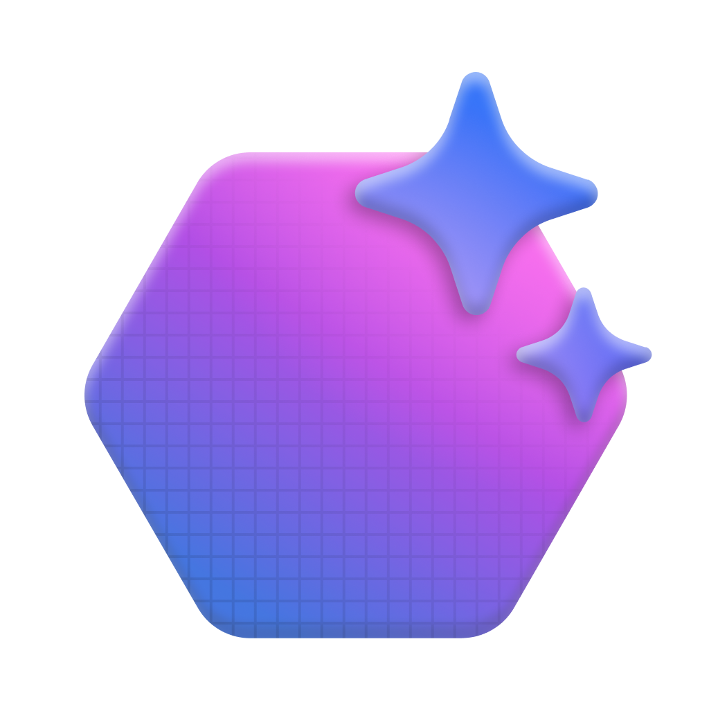



Azure AI Foundry
Model Catalog
Copilot Studio
Foundational models
Open-source models
Task models
Industry models
Visual Studio
Azure OpenAI Service
Azure AI Search
Azure AI Agent Service
Azure AI Content Safety
GitHub
Evaluations
Customization
Governance
Monitoring
Azure AI Foundry SDK
Observability

Slide 9
What value do you get by bringing in AI Foundry?
Access to a broad model catalog
Custom model fine-tuning
Advanced retrieval and knowledge integration
Enhanced capabilities with Azure AI Services
Complex reasoning and workflows
1
2
3
4
5

Slide 10
Demo: BYOM and BYOI

Slide 11
Demo https://aka.ms/mcs/AzureAI

Slide 12











Azure AI Foundry models for specialized tasks
Azure OpenAI
o1/o1-mini
o3/o3-mini
o4-mini
GPT-4o/GPT-4o mini
GPT-Image-1
Sora
GPT-4.1/ 4.1-mini/4.1-nano
Dall*E-3
Whisper
Microsoft
Phi-4
Phi-4-mini/multimodal
Phi-4-mini-reasoning
Phi-4-reasoning/ reasoning-plus
Bitnet
Magma
Aurora
BioEmu
OmniParser v2
DeepSeek
DeepSeek-R1
DeepSeek-V3 0324
MAI-DS-R1 (Microsoft AI)
Meta
Meta-Llama-3
Meta-Llama-3.1-405B
Llama-3.2
Llama-3.3
Llama4-Scout
Llama4-Maverick
CodeLlama
Llama-Guard
Mistral AI
Mistral Large
Mistral Medium 3
Mistral Nemo
Mistral Small
Mistral 7B
Mixtral 8x7B – Mixture of Experts
Codestral
Mistral OCR
Cohere
Command R+
Command R
Command A
Cohere Rerank
Embed v3-Multilingual
Embed v3-English
Embed 4
xAI
Grok 3
Grok 3 mini
Black Forest Labs
Flux Pro 1.1
Hugging Face
Qwen QwQ 32b
DeepCogito
Seethal Sentiment
Roberta
Google Flan
Intel Bert
Cross Encoder
Intfloat Multilingual E5
Cerebras
NVIDIA
Nemotron-3-8B-4k
Nemotron-3-8B-Chat-SFT/ RLHF/SteerLM
Nemotron-3-8B-QA
NIMS microservices inc:
Mistral 7B Instruct v0.3
DeepSeek R1 Distill Llama
Mixtral 8x7B Instruct
Llama 3.2 NV Rerank QA
Stability
Stable Diffusion
Stable Image Ultra
Databricks
Databricks/dbrx-base
Databricks/dbrx-instruct
Industry Models
Fidelity/Saifr
Sight Machine
Bayer
Cerence
Paige AI
Prism
Rockwell
Virchow
RA-FT-Optix
Core 42
JAIS
Gretel
Navigator
Bria
Bria 2.3 Fast
Snowflake
Snowflake/arctic-base
Snowflake/arctic-instruct
SDAIA
ALLaM-2-7b-instruct
Deci
DeciCoder
DeciDiffusion
Nixtla
Time GEN-1
NTT
Data Tsuzumi

Slide 13
Azure AI services
Azure Open AI | Perform a wide variety of natural language tasks with GPT and DALL-E models
Azure AI Vision | Analyze content in images and videos
Azure AI Speech | Speech to text, text to speech, translation, and speaker recognition
Azure AI Language | Analyze natural language text and perform tasks such as entity extraction, sentiment analysis, and summarization
Azure AI Foundry Content Safety | Detect content that is potentially offensive, risky, or otherwise undesirable
Azure AI Translator | Translate text in more than 100 languages
Azure AI Face | Detect and identify people and emotions in images
Azure AI Document Intelligence | Extract fields from complex documents
Azure AI Content Understanding | Extract data from forms and documents, images, videos, and audio streams
Azure AI Search | Extract information from content and create a searchable index and ground data

Slide 14
Extension scenario examples

Slide 15
Ground with proprietary or regulated data
A healthcare provider builds a Copilot Studio agent to help doctors retrieve patient records
Why extend? Fine-tuned models
What are the benefits? Security and isolation

Slide 16
Multilingual support with localization
A global retailer needs an internal support agent that speaks multiple languages and understands regional & dialectal nuances
Why extend? Bring your own model
What are the benefits? Accuracy and relevance

Slide 17
Document understanding + RAG
A financial services firm needs an agent that can answer investment policy questions based on internal PDFs and Excel documents
Why extend? Bring your own index
What are the benefits? More accurate and more grounded answers

Slide 18
What gets better when you extend with AI Foundry?
Response quality
Capability breadth
Business value
1
2
3

Slide 19
What stays the same?
User interface
Existing workflows
User adoption
Governance model
1
2
3
4

Slide 20
Copilot Studio agent extension journey
Start
Current Copilot Studio agent
Enhance
Add AI Foundry capabilities for your scenarios and architecture needs
Expand
Increase sophistication over time
Scale
Enterprise-wide intelligent agents

Slide 21
Start with Copilot Studio and extend with Azure AI when it makes sense

Slide 22
Thank you for participating!

